Slide 1

Geography based Sentiment Analysis using Twitter data
Jigar Mehta, Vishesh Dosaj
Team DataMiners
Data Programming, Fall 2015
Date : Dec 10th, 2015

Slide 2
Approach: Three-Step Project Work flow diagram:
Web Scraping and Data Cleaning
Data Analysis and Prediction
Descriptive Statistics and Classification using Naïve Bayes Classifier – from NLTK
Results and Visualization
Geography Maps, word cloud and Tkinter
Downloaded Twitter data using APIs and stored in MongoDB
Step 1 Step 2 Step 3

Slide 3
Step 1: Web Scraping and Data Cleaning
Twitter Data Streaming from Python and save in “json” format : use filter words for a specific topic
Import the unstructured data : json documents (tweets) in Mongo DB and connect Python to MongoDB to access data
Data Cleaning using RegEx : Tokenization, lowercase, Stemming and Removing Punctuation, Stop Words, @- #, URLs, https:

Slide 4
Step 2: Data Analysis and Prediction
Descriptive Analysis : Compare major KPIs for both Amazon and eBay. Track Top Keywords, Top Hashtags, Top @-mentions and Top users for both
Using unigram approach, develop the Training Data set with labeled data for Naïve Bayes Classifier model - supervised learning algorithm.
Run the Model on test data to classify the sentiments as positive and negative based on tweet content

Slide 5
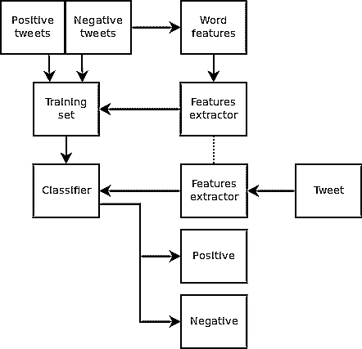
Model Development workflow
Retune the
supervised learning model
Classified tweets

Slide 6
Step 3: Results and Visualization
Tkinter Interface: Develop the GUI dashboard using Canvas for tracking major KPIs for comparison b/w amazon and eBay
Word Clouds, Bar charts, Column Charts and Pie Charts for showing analysis results
Display and Compare the sentiments on a Geography Map for both Amazon and eBay. Highlight the top 10 states
Normalized Sentiment Score =
# Positive sentiments/ Negative sentiments

Slide 7
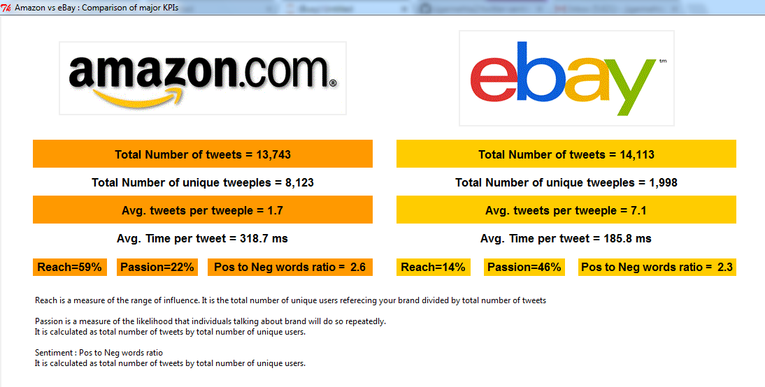
Descriptive Statistics – Tkinter Dashboard

Slide 8
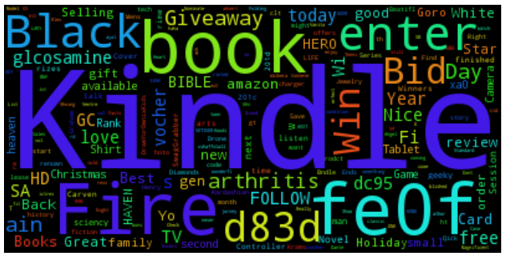
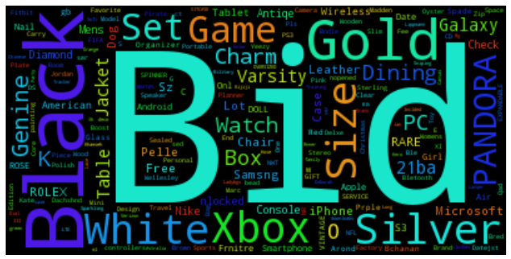
Top Keywords in the tweets – Word Clouds
Amazon
eBay

Slide 9
Challenges Faced:
Unavailability of relevant labeled data for training set
Json file processing in python took forever
Unstructured nested json data
Very high model development time because of text data
Future Scope
Use more advanced and sophisticated models like Logistic Regression and Support Vector Machine (SVM)
Use bigram and trigram approach to better train the model
Use more loops of Feedback mechanism so that the model development is adaptive and further enhanced in real time– predicts and feeds back to its own input - learns from its own results – increases classifier accuracy

Slide 10
Packages Used
NLTK
tweepy
wordcloud
pandas
matplotlib
json
PyMongo
PIL
etc...

